Slide 1
Probabilistic Programming
Marius Popescu
popescunmarius@gmail.com
2021 - 2022

Slide 2
Project 2 Hard Deadline: 01/20/2022 23:59
Bayesian Neural Networks

Slide 3
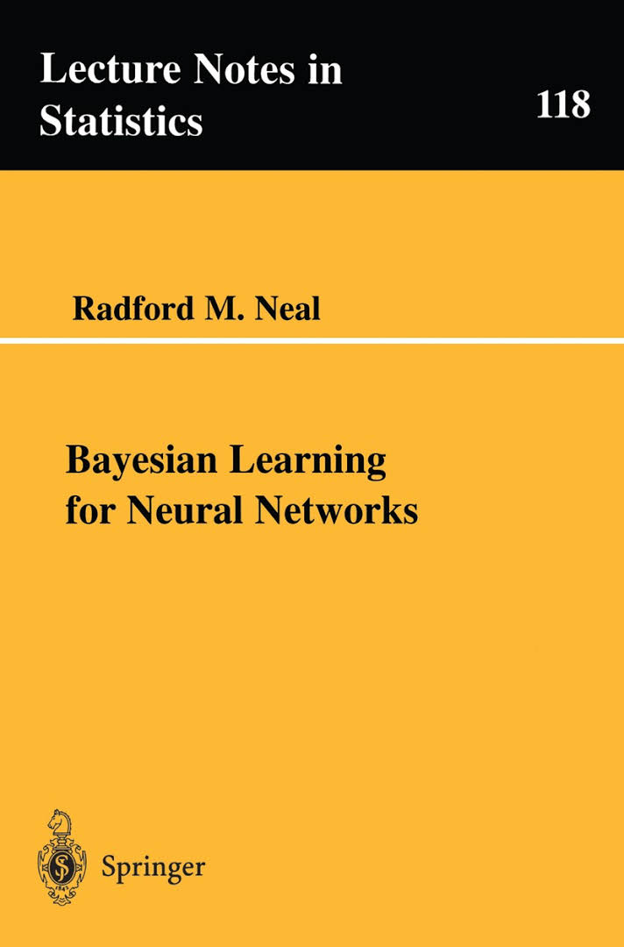
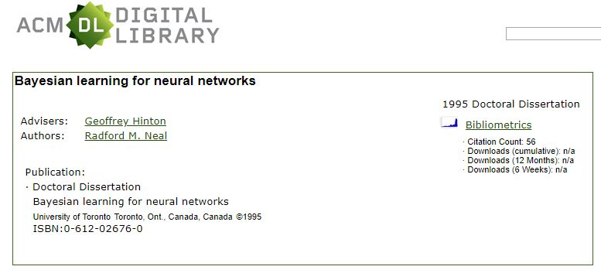
Bayesian Neural Networks
http://citeseerx.ist.psu.edu/viewdoc/download?doi=10.1.1.446.9306&rep=rep1&type=pdf

Slide 4
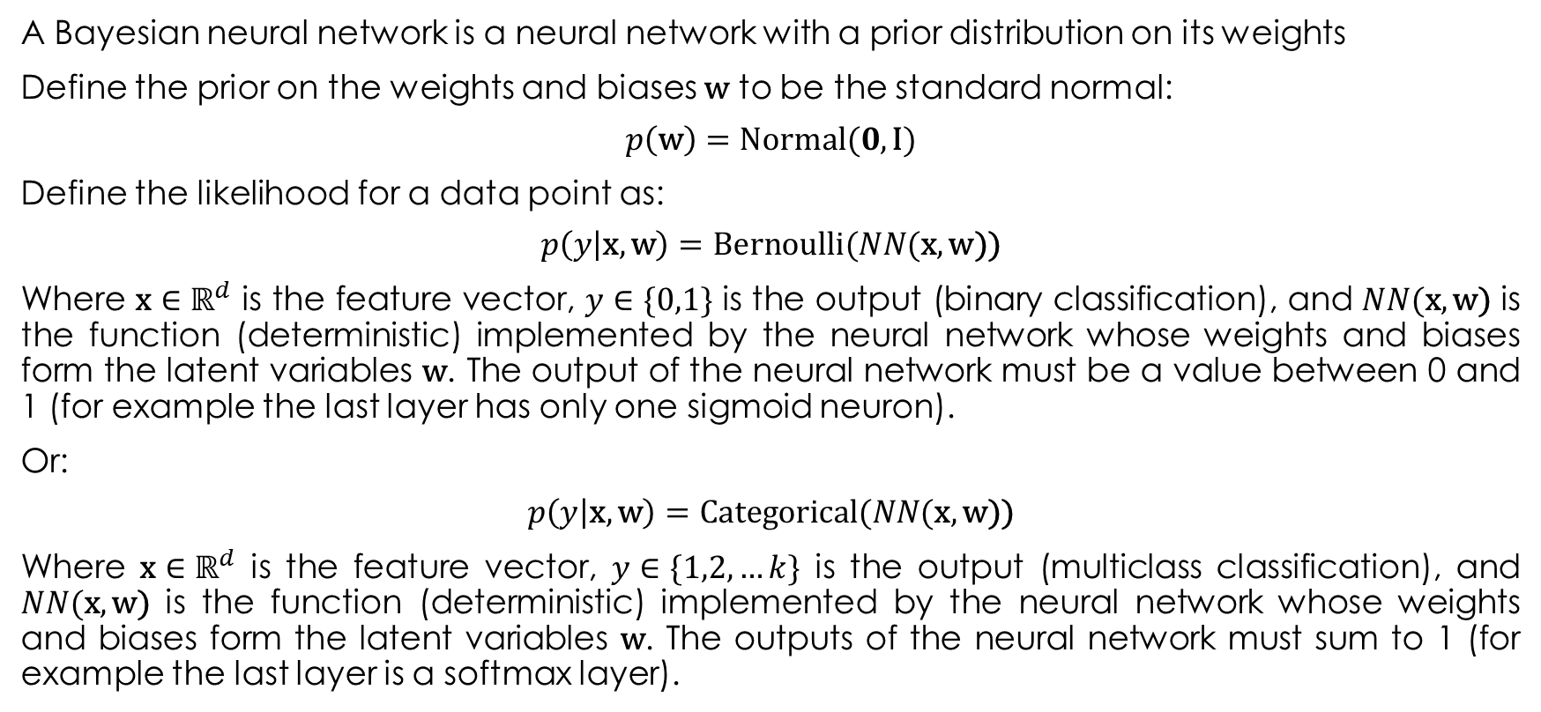
Bayesian Neural Networks
A Bayesian neural network is a neural network with a prior distribution on its weights
Define the prior on the weights and biases $\text{w}$ to be the standard normal:
$$p\left(\text{w}\right)=\text{Normal}(0, \text{I})$$
Define the likelihood for a data point as:
$$p\left(y | \text{x},\text{w}\right)=\text{Bernoulli}(NN(\text{x},\text{w}\text{))}$$
Where $\text{x}∈ℝ^{d}$ is the feature vector, $y∈\{0,1\}$ is the output (binary classification), and $NN(\text{x},\text{w}\text{)}$ is the function (deterministic) implemented by the neural network whose weights and biases form the latent variables $\text{w}$. The output of the neural network must be a value between 0 and 1 (for example the last layer has only one sigmoid neuron).
Or:
$$p\left(y | \text{x},\text{w}\right)=\text{Catego}\text{r}\text{ica}\text{l}(NN(\text{x},\text{w}\text{))}$$
Where $\text{x}∈ℝ^{d}$ is the feature vector, $y∈\{1,2,…k\}$ is the output (multiclass classification), and $NN(\text{x},\text{w}\text{)}$ is the function (deterministic) implemented by the neural network whose weights and biases form the latent variables $\text{w}$. The outputs of the neural network must sum to 1 (for example the last layer is a softmax layer).

Slide 5
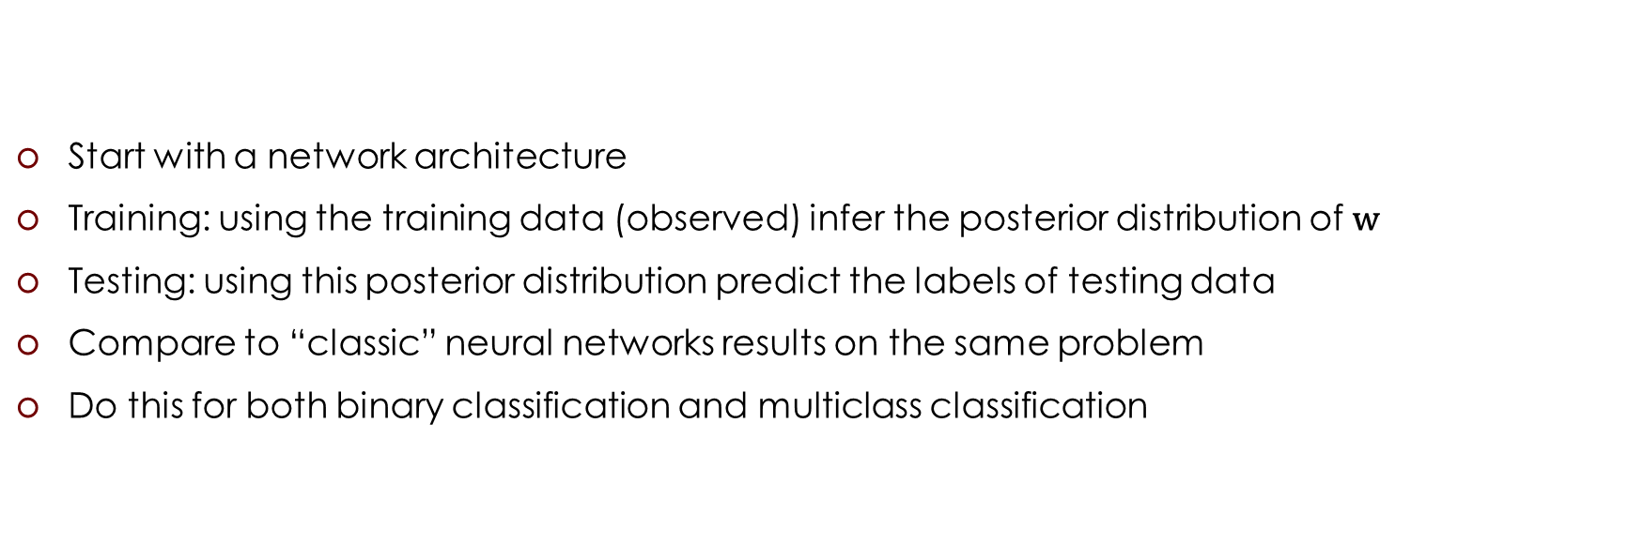
The Task
Start with a network architecture
Training: using the training data (observed) infer the posterior distribution of $\text{w}$
Testing: using this posterior distribution predict the labels of testing data
Compare to “classic” neural networks results on the same problem
Do this for both binary classification and multiclass classification

Slide 6



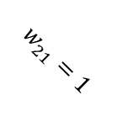







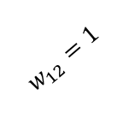
Sanity Check
Take a simple neural network with fixed weights
Generate labeled data (100 training, 100 testing) by feeding random input vectors into this network:
X = np.random.randn(100, 2)
Y = np.tanh(X[:, 0] + X[:, 1])
Y = 1. / (1. + np.exp(-(Y + Y)))
Y = Y > 0.5
$$w_{11}=1$$
$$tanh⁡(x)$$
$$x_{1}$$
$$w_{31}=1$$
$$w_{21}=1$$
$$y$$
$$sigmoid⁡(x)$$
$$w_{12}=1$$
$$w_{32}=1$$
$$x_{2}$$
$$w_{22}=1$$
$$tanh⁡(x)$$
“Train” a Bayesian neural network with the same architecture
Analyse the posterior of weights
Test it

Slide 7
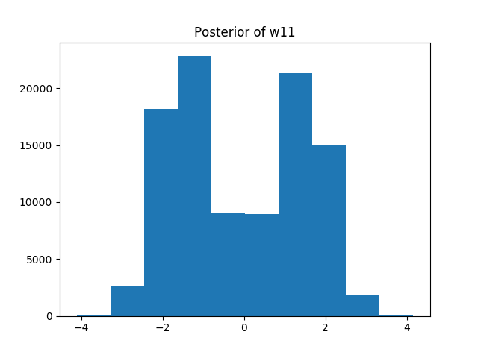
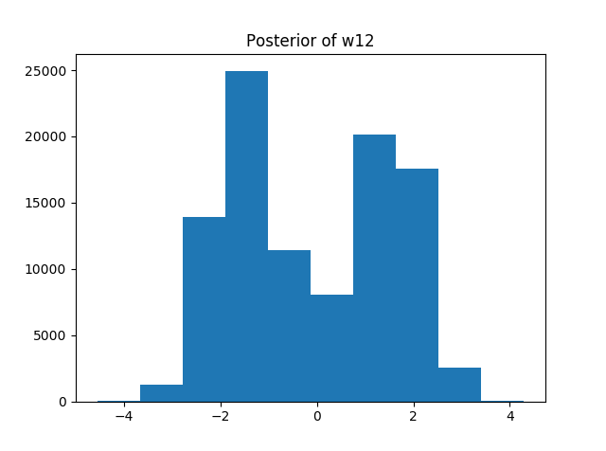
Sanity Check

Slide 8
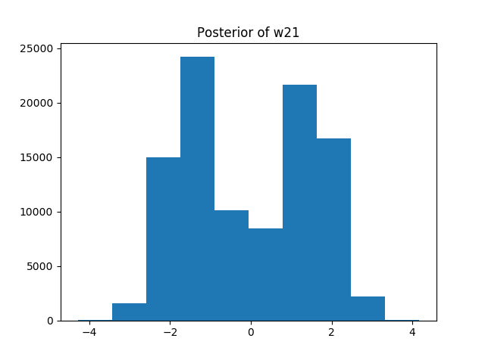
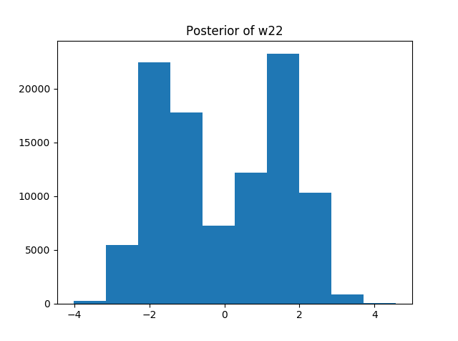
Sanity Check

Slide 9
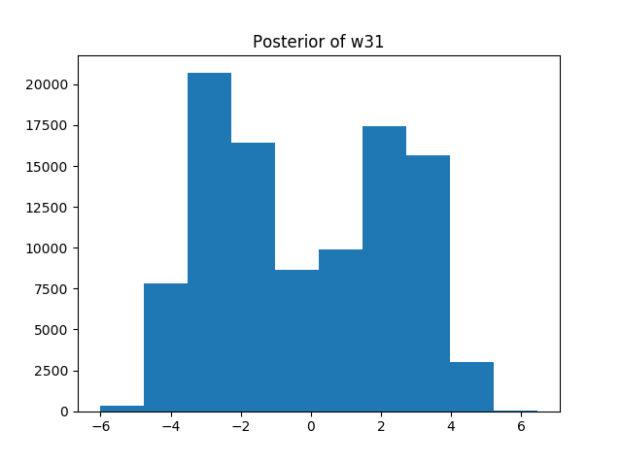
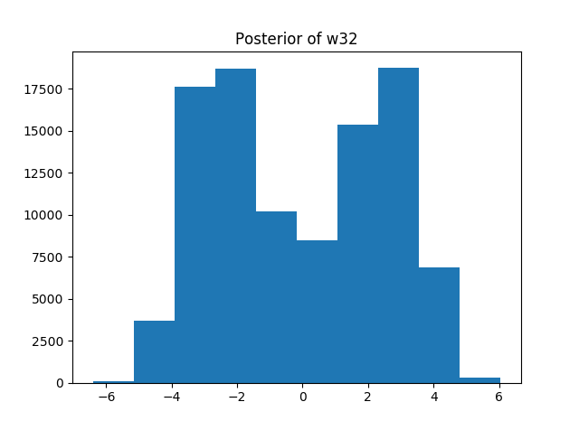
Sanity Check

Slide 10
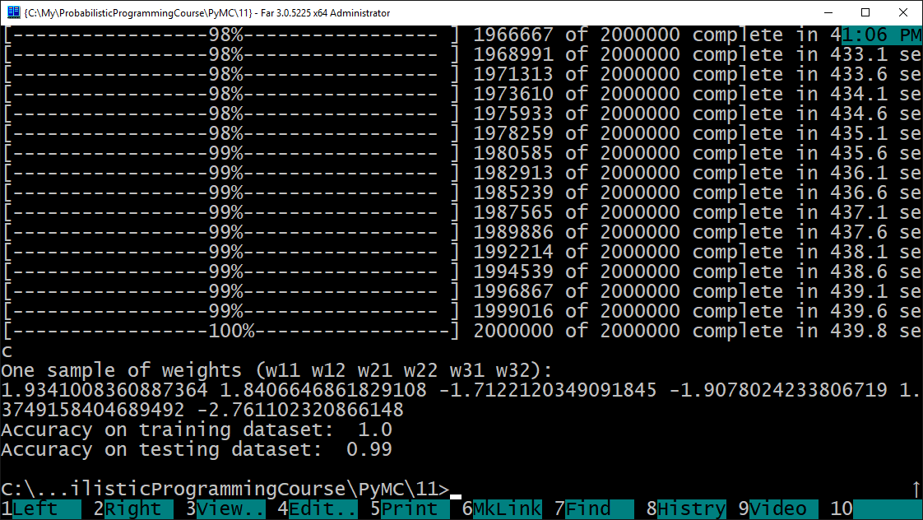
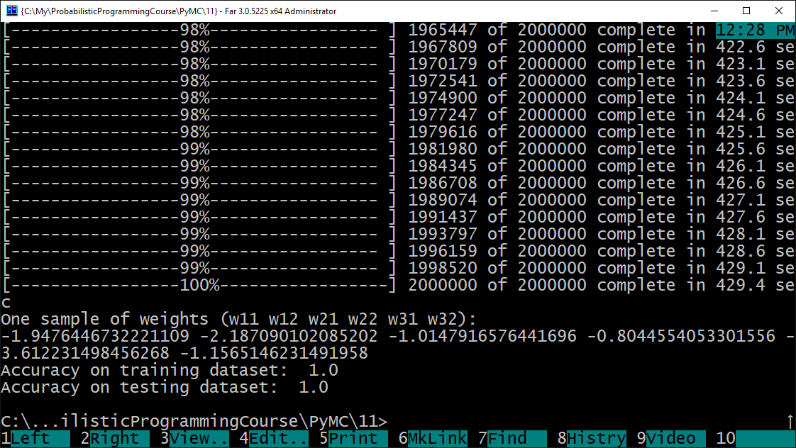
Sanity Check

Slide 11
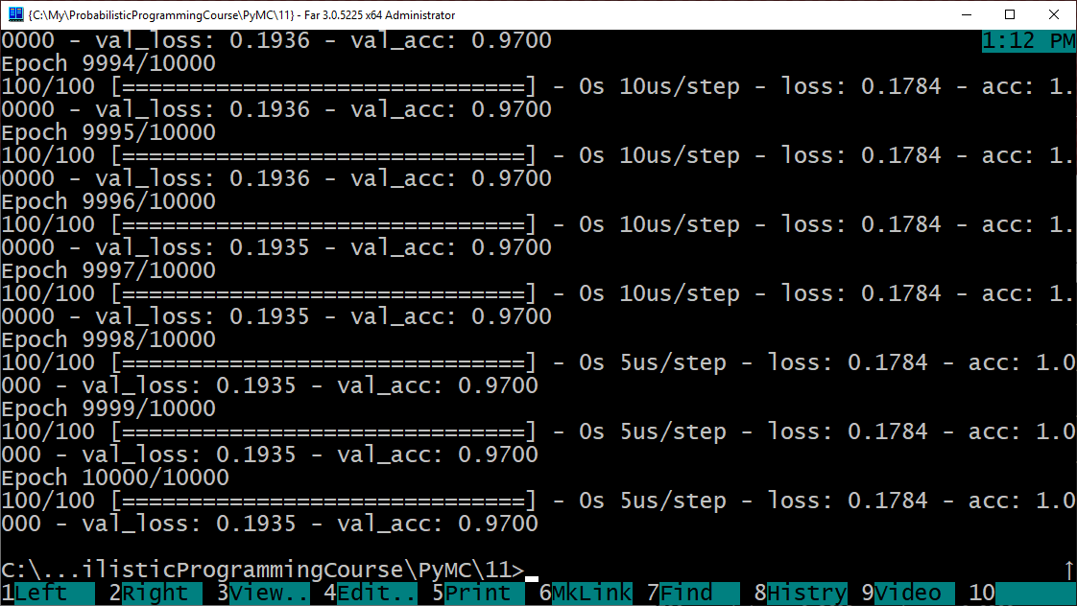
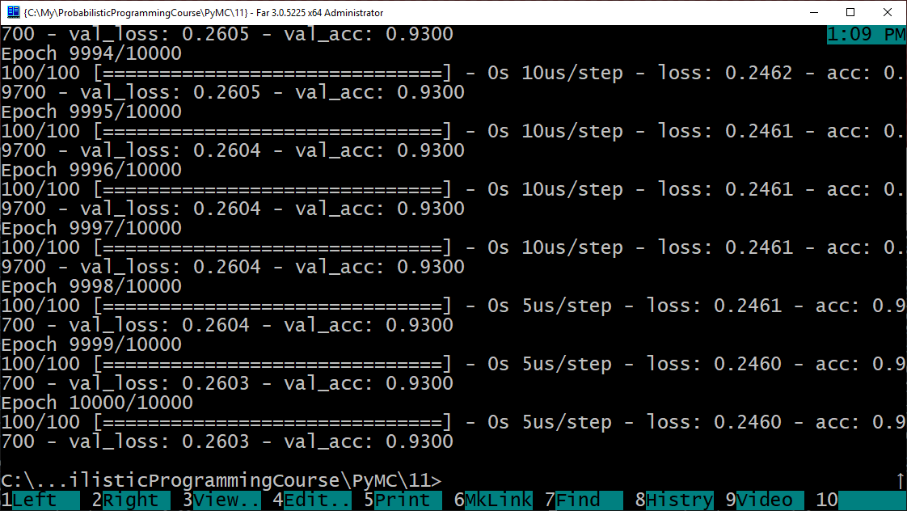
Comparison to “classic” neural networks

Slide 12
Overparametrization May Help Optimization : Folklore Experiment
Generate labeled data by feeding random input vectors Into depth 2 net with hidden layer of size n
Difficult to train a new net using this labeled data with same # of hidden nodes
Much easier to train a new net with bigger hidden layer!
Still no theorem explaining this…
Adapted from Sanjeev Arora's ICML 2018 tutorial “Toward Theoretical Understanding of Deep Learning” (http://unsupervised.cs.princeton.edu/deeplearningtutorial.html)

Slide 13
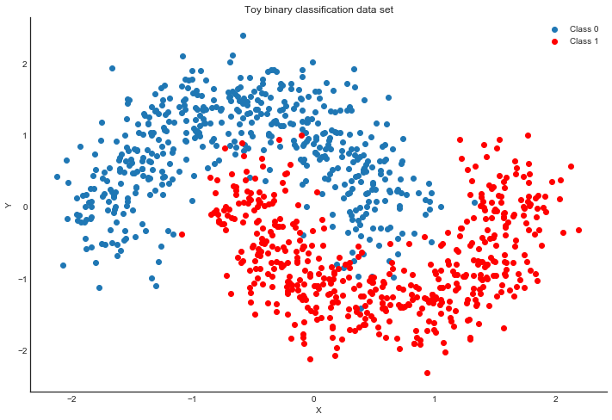
Other small datasets
“Two Moons” dataset: toy dataset for a simple binary classification problem that's not linearly separable.
sklearn.datasets.make_moons(noise=0.2, random_state=0, n_samples=1000)

Slide 14
Extras
Extensions (up to 1.5 points):
Priors over architectures
Weight sharing (CNN, Siamese Networks)
for more ideas see chapter 2 from “Bayesian Learning for Neural Networks”
…

